Slide 1

Team 4.01
/stò·ria/ • history, account, tale, story

Slide 2

Our Personas
Team 4.01

Slide 3

Our Personas
Team 4.01

Slide 4


Our Personas
Team 4.01

Slide 5

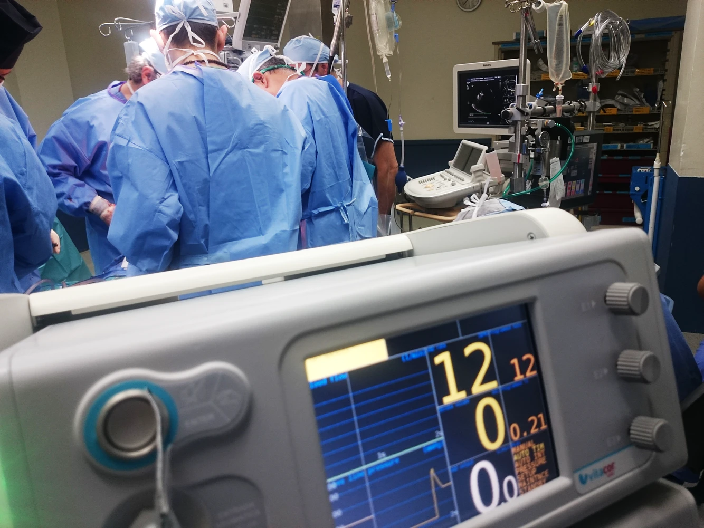
Our Problem
Team 4.01
Medical information is locked within overcomplicated electronic health record portals (EHRs) not readily accessible at the time of need, resulting in patient harm or death.

Slide 6




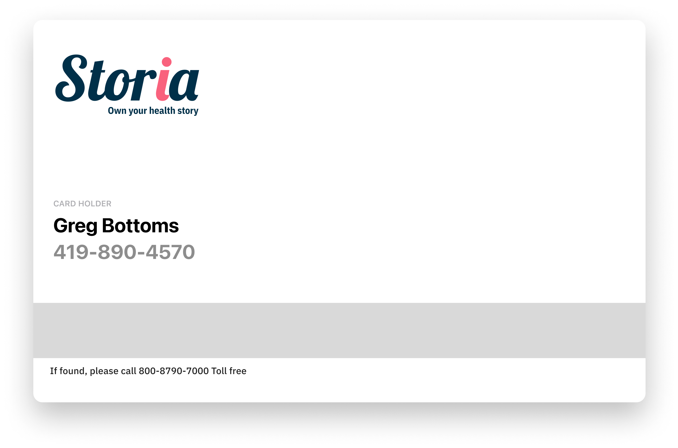
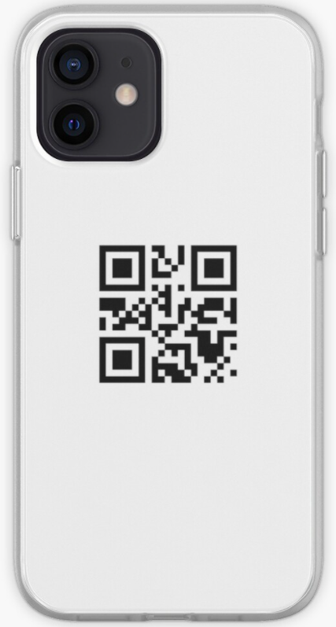

Solution: Storia Health
Team 4.01

Slide 7
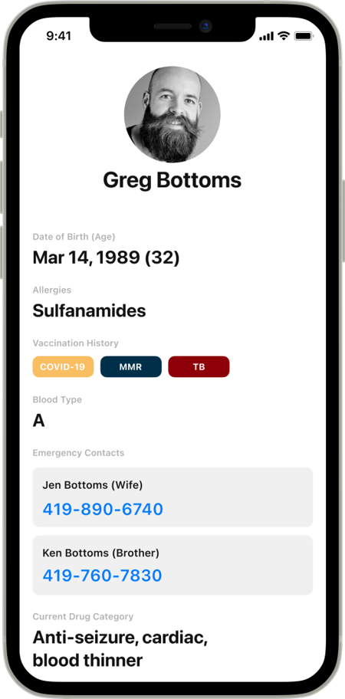
Solution: Storia Health
Team 4.01
1st Layer Health Info:
Demographics
Photo
Allergies
Vaccination History
Blood Type
Emergency Contacts
Medication Categories

Slide 8
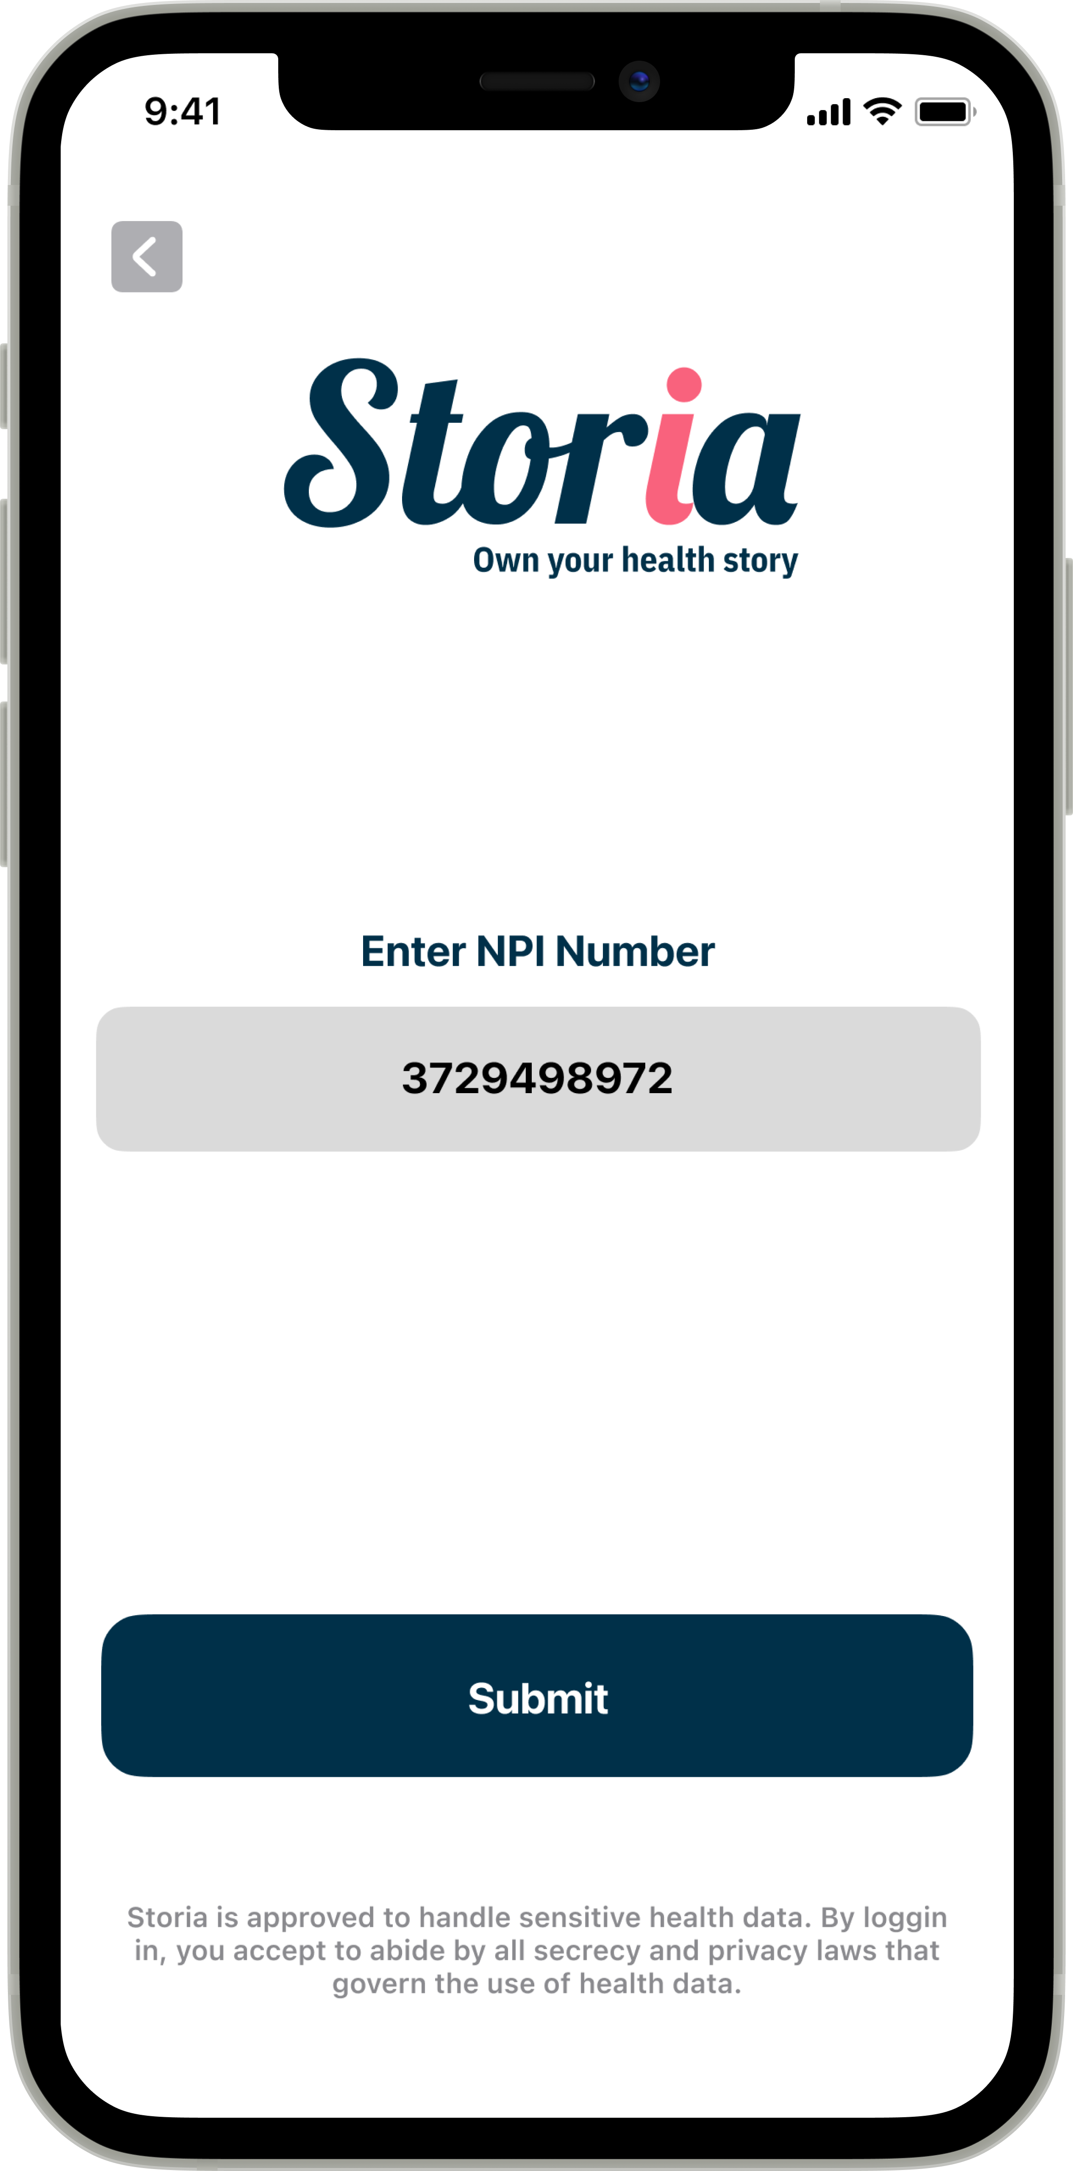
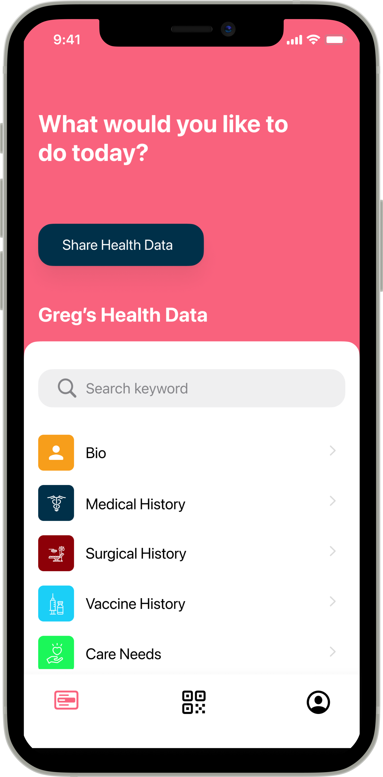
Solution: Storia Health
Team 4.01
2nd Layer Health Info:
Detailed Medical Record
Medical
Surgical
Medication
Care Visit History
Vaccination Scheduling / Validation
Consent Form Copy
Care Needs

Slide 9
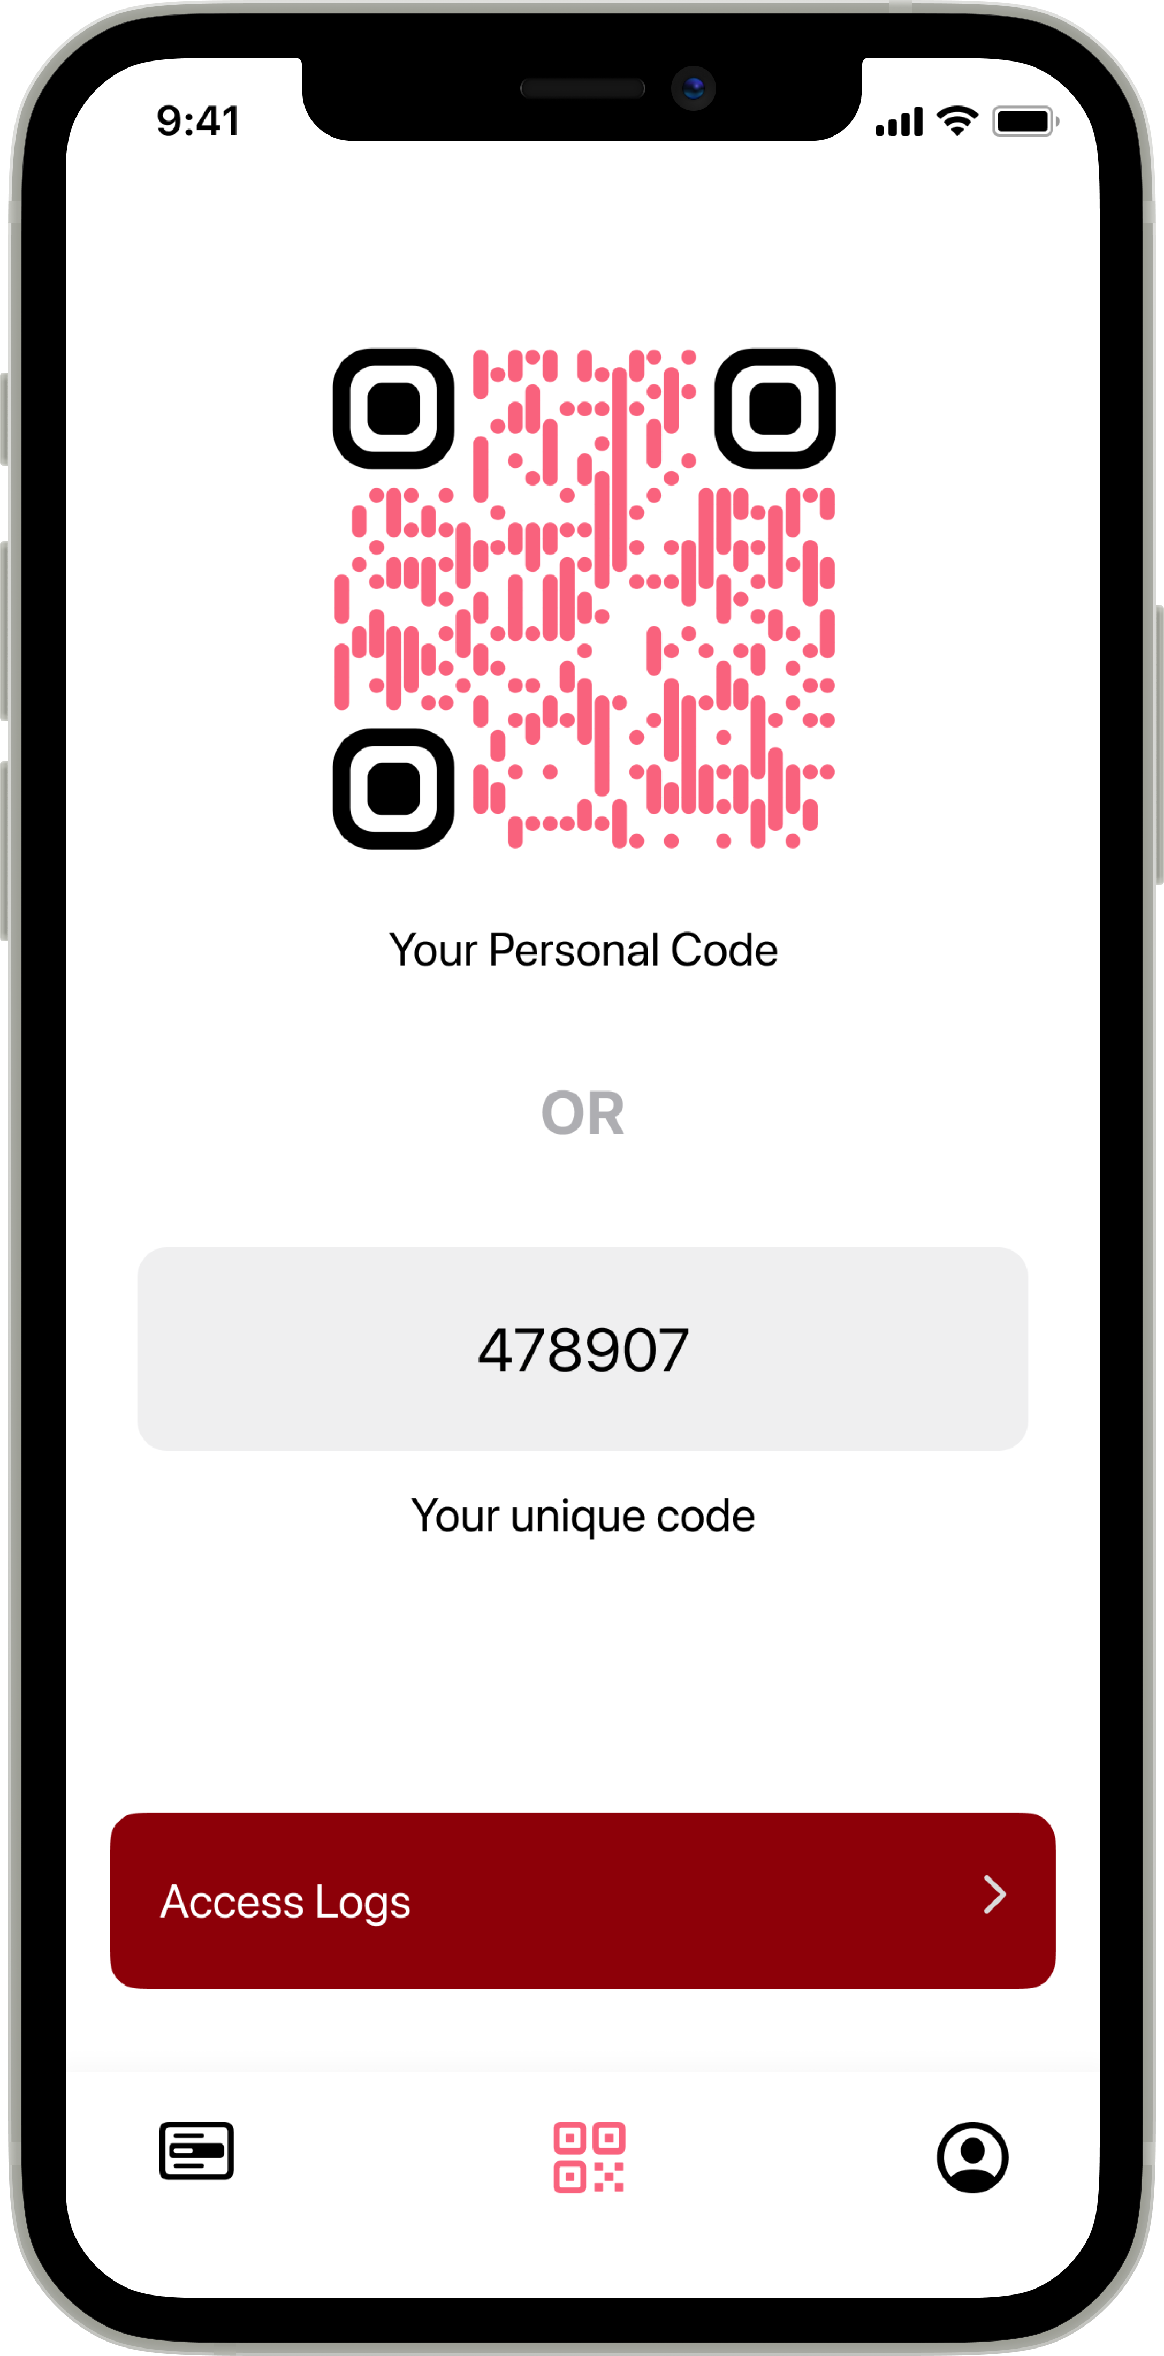



Solution: Storia Health
Team 4.01

Slide 10

The Storia Health Impact
Team 4.01

Slide 11

The Storia Health Impact
Team 4.01

Slide 12


The Storia Health Impact
Team 4.01

Slide 13






Our Team | Storia Health
Team 4.01
Registered Nurse
Product Designer
Solutions Architect
Registered Nurse
Technologist
Student

Slide 14
Thank You
Team 4.01
The Storia Health Team has considered the following:
Interoperability
Value Proposition
Potential Partners
Cost Structure Model
Revenue Streams
Revenue Share Model

